Slide 1
How to Not Annoy Chemists when showing them chemistry
Erin Geno, RDKit UGM
April 2025 Boston

Slide 2

Problem:
Digital space is not physical reality…. And reality is messy.
(Some) scenarios where friction appears:
When reality needs to be captured digitally
> Compound Registration
When ideas need to be turned into reality
> Library Enumeration
Source
Notes:
General concept is friction can happen where theory meets reality. Drug Discovery is a collaborative sport
Folks without much interaction with organic/med chemists may learn something new
Industry veterans will have learned this lesson before, but may benefit from different approaches

Slide 3

Solution:
Yes - digital space is not physical reality…. Don’t worry though we’re in this together…
Think like a synthetic chemist….
The job isn’t done until there’s powder.
More Clear = More Better
Chemists have a million things going on.
Does this tool/workflow reduce mental load?
The why isn’t always clear.
What’s the benefit of the extra overhead?
Source
Notes:
General concept is friction can happen where theory meets reality. Drug Discovery is a collaborative sport
Turns out that’s tricky – both scientifically and logistically
Folks without much interaction with organic/med chemists may learn something new
Industry veterans will have learned this lesson before, but may benefit from different approaches
Chemists live at the transition from an idea to “stuff in a vial”.

Slide 4

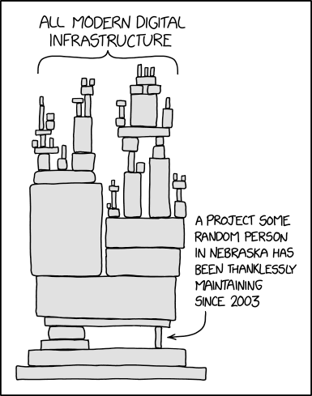
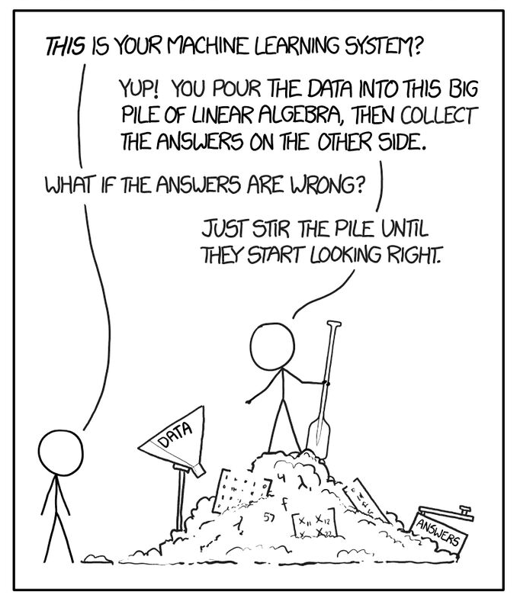

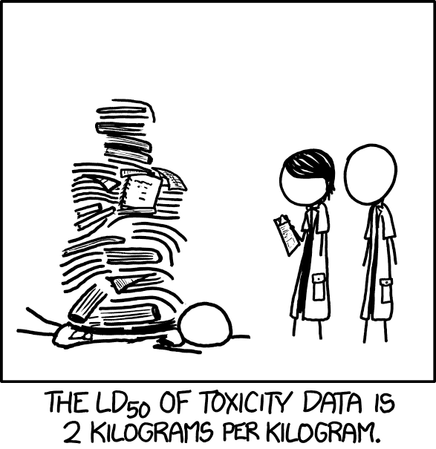
Obligatory Bio Page
Boston University, MA Organic Chemistry
Chemical Methodology and Library Development
Novartis (GDC)
Ariad (Med Chem)
Vertex (Sci Comp)
Relay (Res. Informatics)
Flare (Cheminformatics)
Images attribution: https://xkcd.com/
Notes:
This is the obligatory bio page - why I am I here talking to you about this?
I’ve been on both sides of the fence. First as a medicinal chemist using the tools and then on the other side building tools and workflows.

Slide 5
OK, back to the topic at hand
How to not annoy chemists when showing them:
Enhanced Stereochemistry
Building Block Selections
How do I think like a chemist? How can I make my workflows useful & clear?
Notes:
Some of it is data preparation – some of it is data visualization – all of it is collaboration

Slide 6
Enhanced stereochemistry

Slide 7
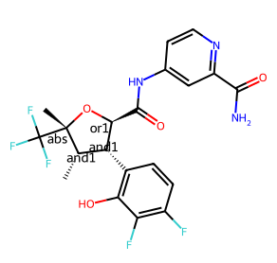
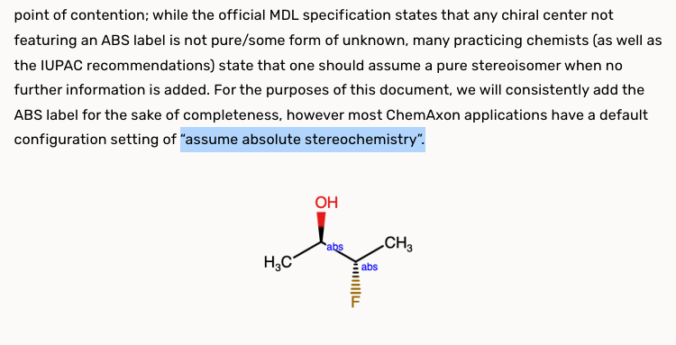
Enhanced Stereochemistry
THE way to digitally represent mixtures of compounds.
Nice blog post about ES in RDKit
https://greglandrum.github.io/rdkit-blog/posts/2023-11-19-explaining-stereo-groups.html
either
WARNING: Not all toolkits make same assumptions for ”ABS”
https://chemaxon.com/blog/presentation/enhanced-stereochemistry-features-how-to-use-them-and-handle-unknowns-and-mixtures
syn
Theoretical Suzetrigine Mixture
Notes:
Take a minute to get everyone on the same page for enhanced stereochem. Reminder for everyone in the room on what enhanced stereochemistry is.
Also a call out ABS flags: so be careful when processing compounds drawn in programs that assume absolute stereochemistry for when a compound has

Slide 8
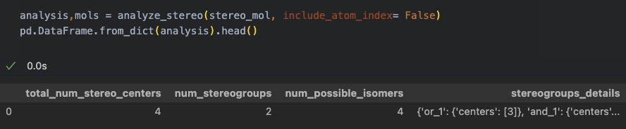
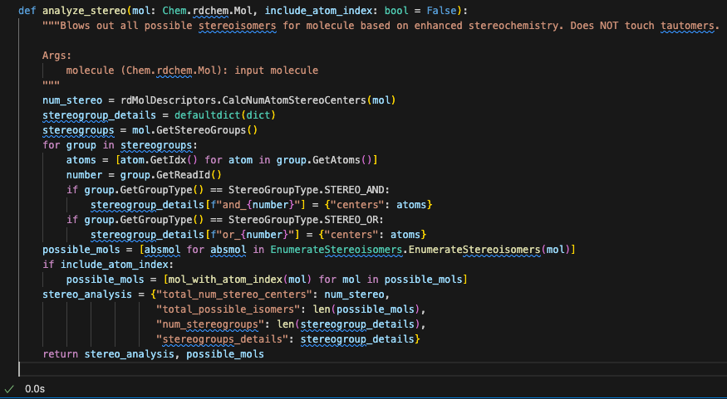
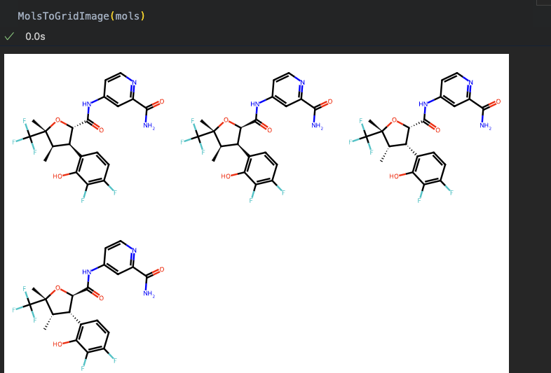
Enhanced Stereochemistry – The Dream
Computationally this is very elegant…
New Look!
Same great compounds,
now with 110% more
accuracy!

Slide 9
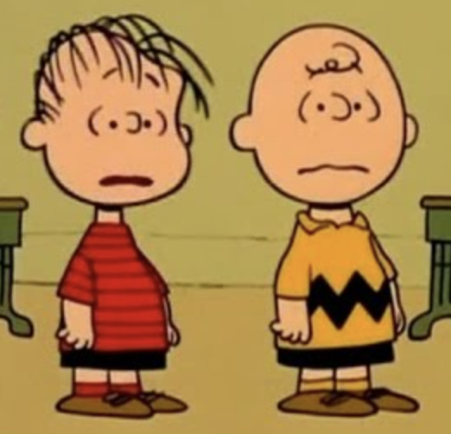
Enhanced Stereochemistry – The Reality
But on registration very confusing….
“Just define groups of simple Boolean logic to explain the mixture that’s in the flask”
No, it doesn’t matter what direction the ”or” bond is drawn
Why is there an “& 1” group with only one stereocenter in it?
No really, it doesn’t matter what direction the “or” bond is drawn
So, if you select the stereocenter, right click, go to the 3rd menu, select and, type in 3…. Well that’s because 1 and 2 are already used

Slide 10
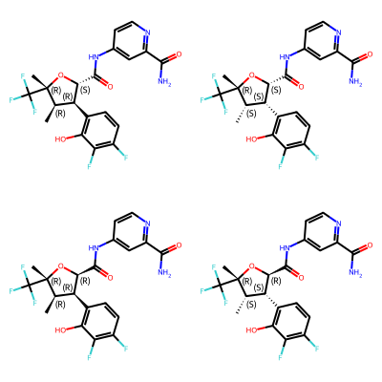
Enhanced Empathetic Stereochemistry
You Drew:
That means:
You have a mixture of 2 diastereomers
Its one of the following Options:
OR
Notes:
Be empathetic to your chemists. If a project team is already dealing with multiple complex stereoisomers they’re probably already vaguely loosing their minds keeping track of all the chiral separations.
I still have yet to see a great user experience when registering with enhanced stereochemistry. Every system assumes chemists are experts and well trained on the enhanced stereochemistry logic.
Also, notice how all the “that means” structures are aligned? Aligning structures automatically to a preferred orientation is a great way to make friends.

Slide 11
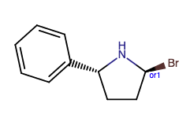
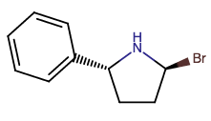
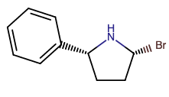
Enhanced Stereochemistry SAR Analysis
SHOW THE BENEFIT OF THE DATA CAPTURE
If the chemists have to jump through hoops on registration, what are you doing with the data?
How can you leverage enhanced stereo when showing SAR?
Registered Structure | Num Stereocenters | Num Possible Isomers | Activity | Putative Active Isomer
 | 2 | 2 | 100 nm
 | 2 | 2 | 1 nm

Slide 12
Building block preparation and selection

Slide 13
Building block preparation
Hey I got this list of available amines from my favorite vendor/CRO. Can we enumerate a 96 member library to blow out the SAR on this spiffy new core we just identified?
ingest bb file
strip salts & protecting groups
uniquify reagents
identify everything with an amine
run the enumeration
.sdf w/ products and reagent structure
“If it doesn’t include the catalog number I’ll be sad”
K. Shortsleeves, actual chemist
Imagine searching for reagents and running chemistry.
Can I buy this reagent?
From Where?
Will it work in my chemistry?
Notes:
So you ingest the file, uniquify the structures, strip salts, deprotect to be able to calculate properties on the BB that will be decorating the core (especially for matrix libraries!), and run an enumeration an any BB that contains an amine.
Imagine searching for reagents and running the chemistry
Can I buy this reagent?
Will it work in my chemistry?
Highlight a laughably ’wrong’ way of doing an enumeration to highlight where it can go wrong and how these choices can impact the ability of your Med Chem friend to order reagents and run a reaction that works.
I’m not going to cover enumeration much but instead focusing on BB prep – BB selection and presenting products back to chemists with BBs still intact.

Slide 14
Building block preparation
Hey I got this list of available amines from my favorite vendor/CRO. Can we enumerate a 96 member library to blow out the SAR on this spiffy new core we just identified?
ingest bb file
FLAG salts & protecting groups
uniquify reagents
identify everything with an amine
run the enumeration
.sdf w/ products, reagents & catalog ID
throw out non-compatible bbs
Or don’t, but DO keep reference to catalog #
What list can I use to order BBs?
What functional groups kill the chemistry?
Notes:
So you ingest the file, uniquify the structures, strip salts, deprotect to be able to calculate properties on the BB that will be decorating the core (especially for matrix libraries!), and run an enumeration an any BB that contains an amine.
Imagine searching for reagents and running the chemistry
Can I buy this reagent?
Will it work in my chemistry?
Highlight a laughably ’wrong’ way of doing an enumeration to highlight where it can go wrong and how these choices can impact the ability of your Med Chem friend to order reagents and run a reaction that works.
I’m not going to cover enumeration much but instead focusing on BB prep – BB selection and presenting products back to chemists with BBs still intact.

Slide 15
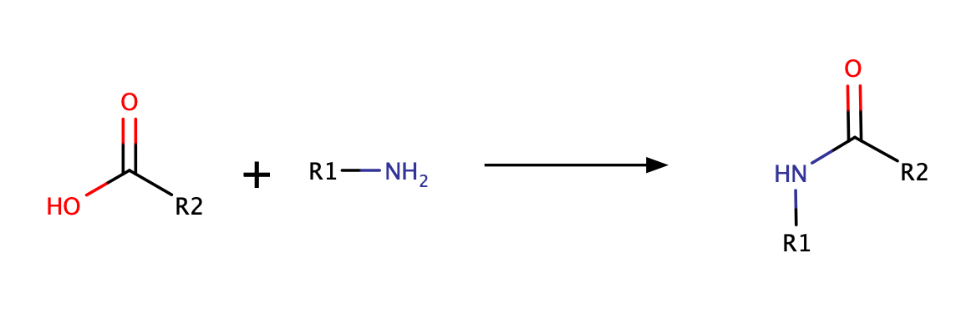
Reaction kill rules
Requires:
- Primary or secondary amine (not amide),
- ONLY one reactive amine <- this is a case where storing BBs with PGs attached helps
NO:
- carboxylic acids
This is thinking like a chemist!
Notes:
BB selection

Slide 16
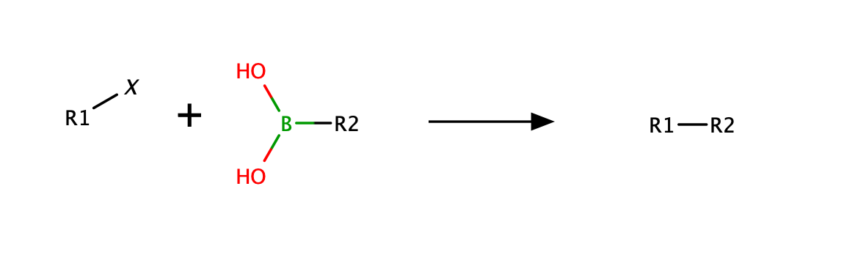
Reaction kill rules
Requires:
- Boronic acid or ester. BF3K maybe ok.
NO:
Aryl Halides
Probably No:
- Palladium poisoners (ex: nitriles, nitros, nitrogen containing heterocycles)
But not all reactions are easy.
Rules may change depending on the core.
Notes:
Review these with your synthesis team. Its how to make friends and influence med chemists

Slide 17
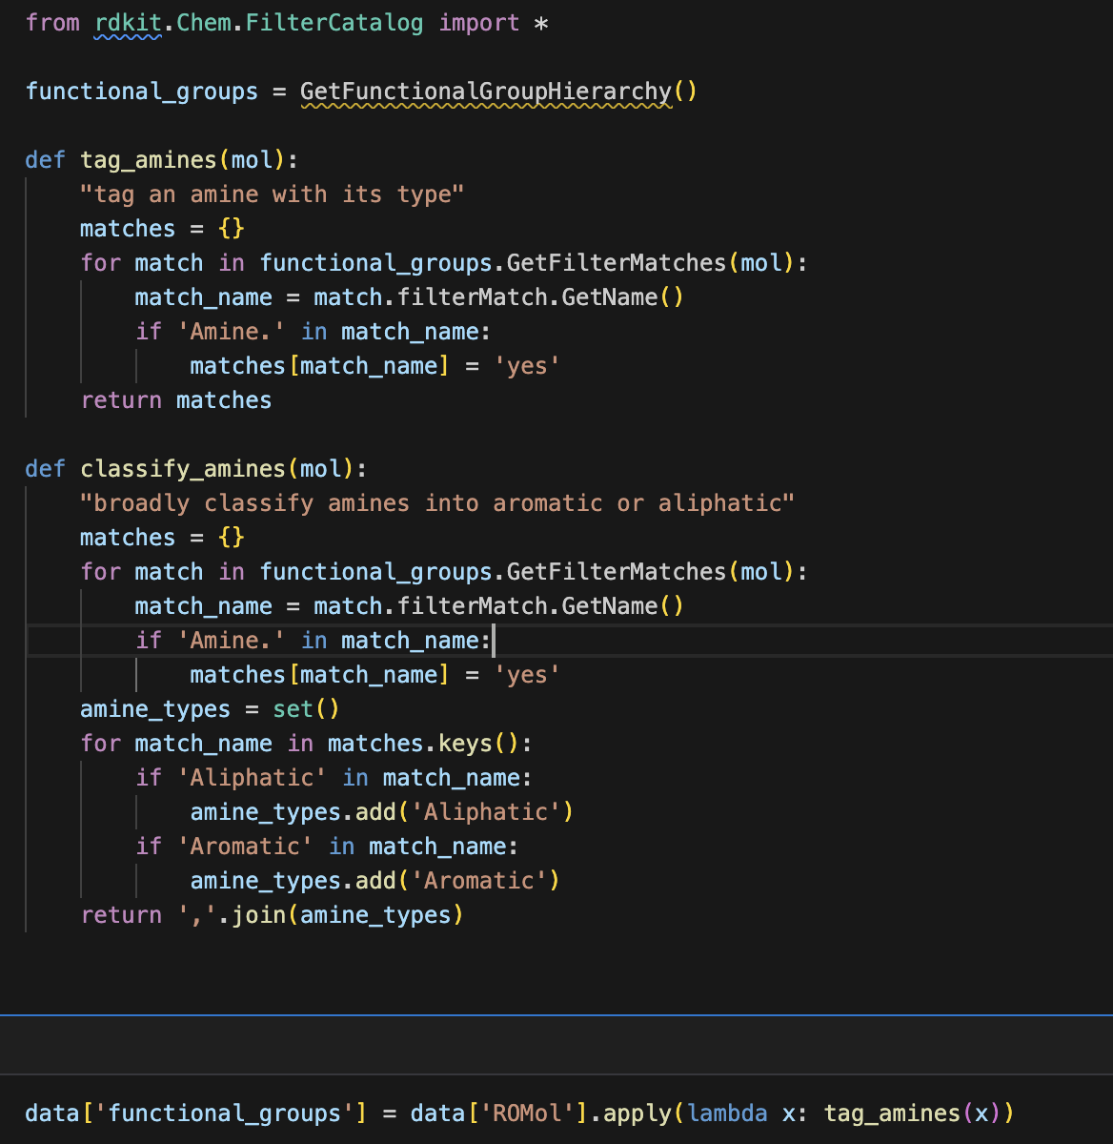
Functional groups using FilterCatalog
Note the catalog ID

Slide 18
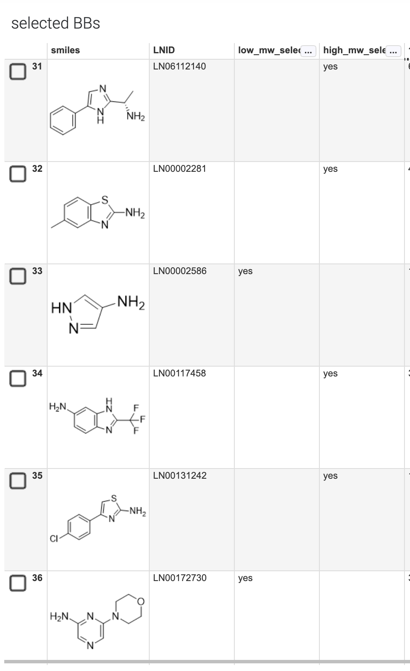
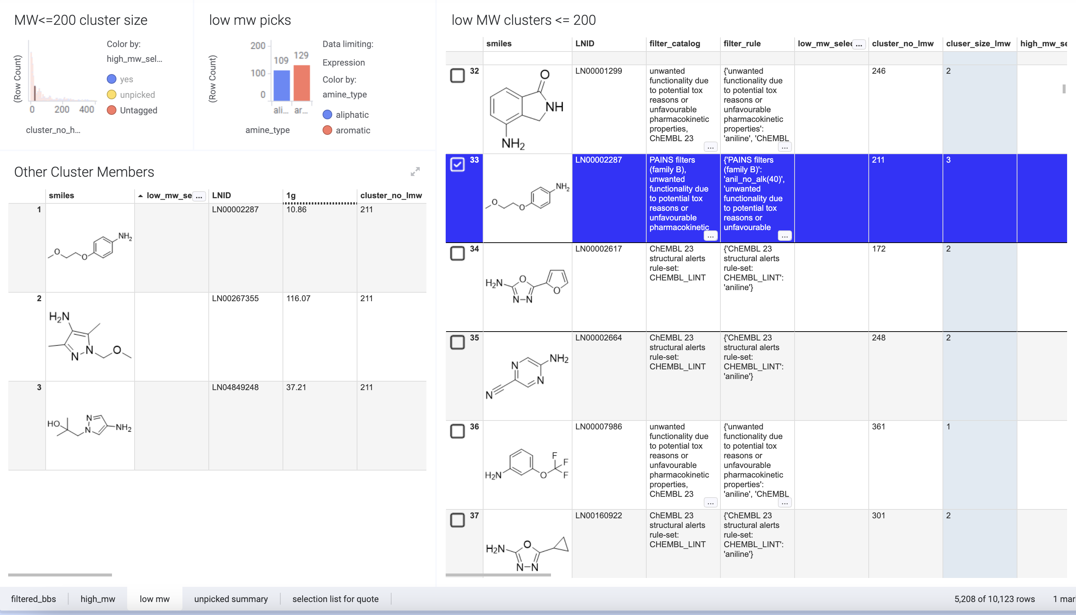
Presenting cluster picks
Some way to allow chemists to swap out the selection from clusters helps transparency and collaboration
Be ready create an order list for the next step
Notes:
BB selection & presenting back results.

Slide 19





Thank you to my colleagues & collaborators past and present
Liana Allen
Khuong Ding
Dave Dunstan
Tony Garcia
Jacob Gora
Tim Hopper
Steven Kearnes
Brian Kelley
Trevor Kramer
Ian Pendleton
Joann Prescott-Roy
Susie Roberts
Kelley Shortsleeves
Rebecca Swett
Dawn Troast
Jeff Orr
Rainer Wilken
Brian Webb
Jason Yuen
Yutong Zhao

Slide 20
THANK YOU

